Slide 1
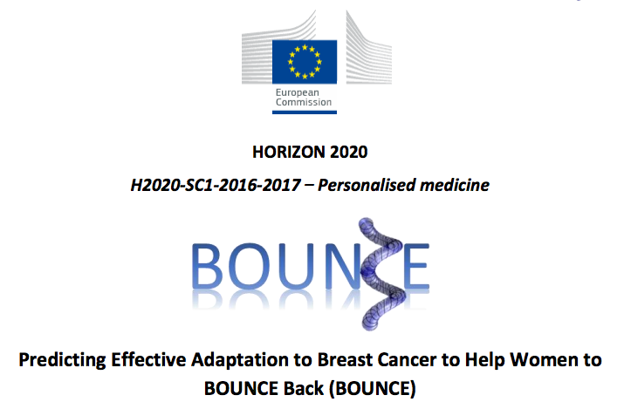

Processes and Mechanisms Involved in Psychological Adaptation to Cancer: An Overarching Theory for BOUNCE
E.C. Karademas, K. Marias, G. Manikis, E. Koumakis, & P.G. simos
FORTH

Slide 2

Overview
Self-regulation
Self-regulation and adaptation to illness
  the Common Sense Model (CSM) of Self-regulation
CSM as the backbone of the BOUNCE theoretical framework
The “ontology” of the variables included in BOUNCE and their inter-relations
Implications

Slide 3
Self-regulation
Self-regulation refers to the several procedures by which the human agency exercises control over its many functions, states, and inner processes (Vohs & Baumeister, 2004).
    Conscious/deliberate efforts and unconscious/automatic processes used to monitor the state in relation to GOALS and alter inner states or responses/behavior so as to achieve goals.
    Thoughts,
    emotions,
    impulses,
    task performances,
    attentional processes

Slide 4
As Carver and Scheier (2016) summarized it:
goals…
    are dynamic,
    exist at many levels of abstraction (e.g., in a hierarchy or in the form of “programs of action” – Power, 1973).
human behavior…
    is seen as reflecting a dynamic, goal directed and feedback controlled mechanism,
    which aims in making corrective adjustments (originated from within) so as to help the person stay on track,
    in case that a discrepancy between the present and the desired or intended condition is observed.
regulation works as a dual (mutually affected)-process feedback system:
    a behavioral-guiding action loop aiming in reducing discrepancies,
    an automatic, parallel emotional process checking how well the first system is doing at reducing discrepancies (e.g., a negative affect reflects an error signal in the action loop), and calling for action or reprioritization of goals.

Slide 5
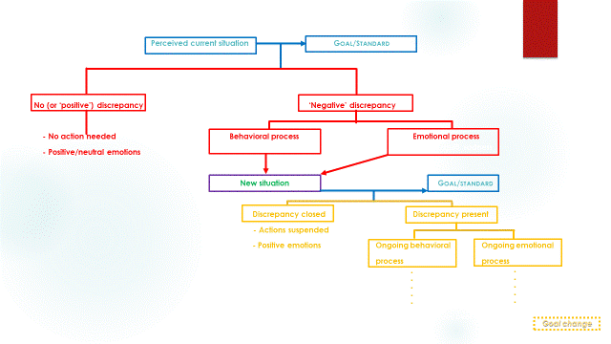
Person monitors… and compares against…
Perceived current situation Goal/standard
No (or ‘positive’) discrepancy ‘Negative’ discrepancy
- No action needed Behavioral process Emotional process
- Positive/neutral emotions
New situation Person compares against… Goal/standard
Discrepancy closed Discrepancy present
- Actions suspended
- Positive emotions Ongoing behavioral Ongoing emotional
process process
Corrective actions
e.g., worry, guilt, sadness
Goal 1
Goal 2
Goal 3
.....
.....
Goal X
Continues over time
Goal change

Slide 6
People often have to manage multiple goals and several self-regulatory processes simultaneously.
So, there is need for specific theories to unpack self-regulation in particular situations and explain how it succeeds or fails, as well as the unique processes that take place in those situations.

Slide 7
Self-regulation and adaptation to illness
The health domain poses a challenge for SR theories due to the substantial discrepancy between the importance of health-related goals and the frequent failure to act on these goals.
Moreover, some of these goals may not be “own” goals but “given” by the health professionals (de Ridder & de Wit, 2006).
This is particularly true for chronic illness and patients with a life threatening or severe condition.

Slide 8
The Common Sense Model (CSM) of Self-regulation in Illness
Adaptation to illness is a dynamic and complex self-regulation process.
It’s based on patient’s ability to
    interpret information
    associate perceptual events (e.g., symptoms) to abstract concepts (e.g., representations)
    transform information into action plans
(Leventhal et al., 1980; Leventhal et al., 1992; Leventhal et al., 2005)

Slide 9
The process is initiated by a felt symptom or perceived deviation from normal function, or by external stimuli.
Next, an illness schema or “prototype” is activated, based on previous history, knowledge and beliefs.
Then, patients develop dynamic cognitive and emotional representations about illness/symptom and potential treatment so as to make sense of their condition (e.g., “I am probably just tired. Nothing to worry about”).
Guided by illness representations, patients develop short- and long-term action plans and coping procedures in order to manage symptoms and regulate emotions (e.g., “Have to rest for a couple of days”).
Evaluation of the entire process (“Am I better?”) – comparison with expected or desired outcomes.
Constant feedback loops – system coherence/non-coherence: secures continuation of behavior/changes in representations and behavior.

Slide 10
There is strong empirical support for the model (e.g., meta-analyses by Dempster et al., 2015; Foxwell et al., 2013; Hagger et al., 2017; Hudson et al., 2014).

Slide 11
CSM and cancer: Empirical data
Several illness representations are related to coping behaviors, psychological adjustment and quality of life.
In general, a representation of cancer as a more controllable and less severe condition is related to better adaptation to cancer and improved health outcomes (e.g., better physical functioning and psychological well-being), whereas a representation of a severe and chronic illness is related to worse health (Hickman & Douglas, 2010; Richardson et al., 2017).

Slide 12
A recent study (Hopman & Rijken, 2015) showed that:
  Many cancer patients, especially during the period after treatment, believe that their condition will be long-lasting and drastically changing their lives.
  The strongly believe that their cancer treatment is effective.
  Especially breast cancer patients quite strongly perceive psychological factors as a cause of their condition.
  Negative emotional responses are associated with more ‘passive ways’ of coping (e.g., helplessness, fatalism).
Also, Ashley et al. (2015) showed that even after controlling for clinical and sociodemographic variables, illness representations (particularly, consequences, identity and emotional representations) were the best individual predictor of 9/12 HRQoL domains, 12 months after baseline.

Slide 13
Self-regulation, CSM and BOUNCE
The CSM will stand as the basic theoretical model for the formation of the prediction models and the identification of predictive factors.

Slide 14
The BOUNCE prospective study: summary of variables measured

Slide 15
Considering the variables included in BOUNCE, and based on the CSM suggestions, a basic model of the relationships between variables may look like this:
Medical events &
Personality/traits
Medical condition Illness representations Coping behaviors Outcomes

Slide 16
Especially with regard to Resilience
resilience-as-trait may…
  be predictive of specific parts of the self-regulation process
Positive representation of cancer
(e.g., as a more controllable condition)
More functional coping behaviors (e.g., make plans, adhere to medical advice)
Better outcomes (e.g., fewer psychological symptoms)
Trait resilience-T1
Notes:
Familiarize with T1- terminology

Slide 17
resilience-as-trait may also …
  affect the basic self-regulation mechanism by moderating/regulating the associations between its different aspects.
Positive representation (e.g., high level of perceived control over illness)
More functional coping (e.g., adherence to medical advice)
++
Better outcomes (e.g., fewer psychological symptoms)
High levels of trait resilience-T1
--
Negative representation (e.g., low level of perceived control over illness)
Dysfunctional coping (e.g., avoidance, helplessness)

Slide 18
Resilience as process…
may be inferred from the observation of positive adaptation to illness and better outcomes, despite any negative event (e.g., initial diagnosis, subsequent treatment side-effects, negative test results)
Diagnosis
Mental health, QoL, etc
Negative event (stressor)
T1 T2 T3 Tn
Notes:
We could model trait resilience trajectories over time and assess the association between different trajectory shapes to end-point outcomes…
Instead of looking at resilience through the “eyes” of the patients ie. Subject to report bias (which is also likely to be affected by illness representations, coping strategies etc), we can also look at resilience by modeling the person’s affective and behavioral responses to the disease and to subsequent negative events (i.e. stressors)
Hence the second definition of resilience as process..
Important step to define how affective/behavioral responses will be measured, and if physical health should be included (as it relates closely to ongoing negative events)

Slide 19
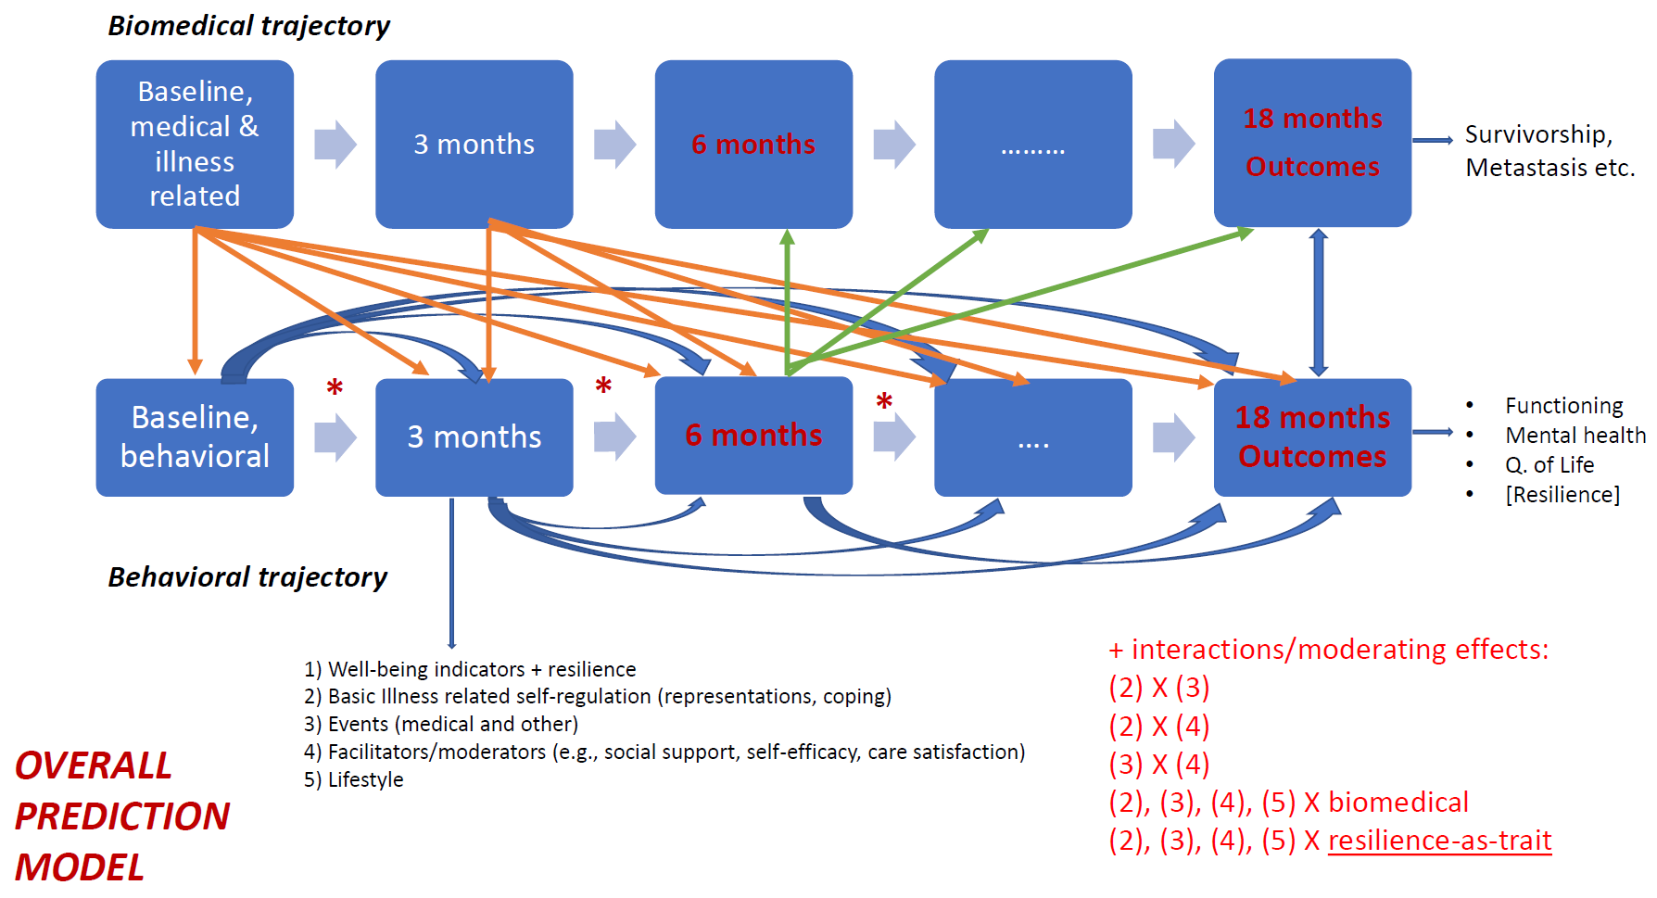
The full model accounting for the main outcomes
Aim: to identify those variables or interactions that can more accurately account for final and intermediate important outcomes.
Outcomes may be predicted by
the variables (or their interactions) assessed at the immediately previous time-point,
the factors (or their interactions) assessed at all previous time-points and baseline,
the interactions between variables assessed at different time-points.
Notes:
We will most likely not be able to assess the full model (i.e., will all main effects and interactions) due to power issues

Slide 20
Further thoughts on the basic model
The process of adaptation to cancer is probably characterized by a choreography of dynamic changes in several of its aspects.
It is possible for the changes in the basic self-regulatory variables (illness representations, coping behaviors, reappraisals etc.) to be associated with corresponding changes in the ways that facilitating factors (e.g., self-efficacy) change over time, and for both of these patterns of change to be associated with variations in health outcomes.
Hence, the examination of the potential impact of the dynamic changes in different variables (or a set of the most important of them) on corresponding changes in health outcomes is warranted.

Slide 21
additional simple(r) pathways to be examined
Medical events
(changes in) Self-efficacy
(changes in) coping behaviors
(changes in) health outcomes
Illness representations
Fear of recurrence
Distress
Health outcomes
Sense of coherence
Self-rated health
Coping behavior
Health outcomes

Slide 22
BOUNCE Project: The Implications
From modelling to actionable insights
  Crucial patient characteristics at each time point may lead to specific suggestions for the health professionals (e.g., regarding information needed to be conveyed to patients, potential referral to counselling). For instance,
    Although patient A showed a very good adaptation and high resilience at the beginning of treatment, six months later her condition deteriorated. Now, she reports significant difficulties in performing daily chores, and scores very high in the scales of depression and anxiety. She also reports high levels of helplessness.
    The system informs her attending physician about these scores and suggests specific actions, such as bringing her in contact with a mental health professional for a full evaluation.

Slide 23
The results of this project will help practitioners to better predict patients’ adaptation to cancer, as well as the factors that contribute to or impede progress.
This may facilitate the successful management or even prevention of adaptation problems.
The results may advance our understanding of the role of resilience as a crucial personal resource for dealing with cancer and its consequences, and for achieving an improved quality of life.
The results may also allow a better description of the particular micro-processes that take place within the broader self-regulation mechanism and are important for adaptation to cancer.
Finally, the results may provide the opportunity to examine the accuracy of existing theories and models regarding adaptation to illness and patients’ well-being.

Slide 24
Thank you very much!

