Slide 1
Group Intervention for Women with Early Stage Breast Cancer
Shlomit Perry, Yaira Hamama-Raz, Ruth
Bar-Levav, Ruth Pat-Horenczyk
Davidoff Cancer Center - Israel

Slide 2
Group Intervention for Early Stage Breast Cancer
Aim & goals - To build resilience, enhance physical, cognitive, emotional & interpersonal functioning and flexibility
Theoretical framework- resilience approach; self regulation; cognitive-affective-and social processing theory
Target Population – Diagnosis of BC, at least 2 months after completion of adjuvant chemotherapy
Closed Semi-structured group intervention (8 sessions)
6 groups for Hebrew speakers, 1 for Arabic speakers

Slide 3
The Theoretical Model
Group intervention
The power & dynamic of the group
Coping skills
Psycho-education
Resilience & self regulation

Slide 4
Structure and Framework of Meetings
All sessions have the same structure and a defined topic
Opening/Checking in opens the meeting by collecting comments referring to the previous session “how I went from the last session and where I am currently”
Psycho-educational information - relevant to the cancer experience and psychosocial coping
Experiential exercise – according to the session’s topic
Practical skills - empowering the ability to cope
Closing - summary of experience, clarification of questions arising during the session & home-work

Slide 5
The topics of the session
Introduction - Becoming a Group, Presenting the Concepts of Resilience and self regulation
Clarify the psychological “contract“, the fear of talking about fear and emotions. Focusing on the body through a “relaxation experience”
Thoughts – identifying our thoughts, distinction between thought and emotion. Explaining the interaction between thoughts - emotions & behaviors
Perception of the disease (fantasies) - Why me? Is there any explanation for the disease? Is it important to look for the cause? (based on the common-sense model)

Slide 6
Content of the Sessions (cont)
Emotions- identifying, naming, regulating and managing emotions
Interpersonal relations - the partner, family and society, the cancer as a family narrative
Ways of coping - learn to identify our ways of coping, learn from the others.
Evaluate and summarize the individual and group process

Slide 7
Reasons for Refusal (N = 342)
N=342 % | REASONS
27 | Participated
20 | No information
20 | No time, too busy
13 | I am ok, don’t need help
13 | Objective reasons –live far away
9 | Don’t want illness reminders
2 | Don’t want group treatment
2 | Other
0 | Do not believe in psychological treatment

Slide 8
189 Breast cancer Pt completed adjuvant treatment
88 - Refused to participate in the study
56 – Group + questionnaires
(30%)
45 only questionnaires
16 drop out
(28%)

Slide 9
תוצאות
Results: Socio-demographic & Medical Factors Study Participants vs. Non-Participants
101 women
88 - Refused to participate in the study
56 – Group + questionnaires
45 only questionnaires
No significant differences were found between the groups

Slide 10
Socio-Demographic and Medical Factors:
Participants vs Non-Participants
133 women
45 only questionnaires
56 – Group + questionnaires
88 - Refused to participate in the study
No significant differences were found between the groups

Slide 11
המשך ממצאים
Psychological Characteristics
Group Participants vs Non-Participants
At first measure T1 (Baseline)
45 - only questionnaires
56 - Group intervention
Higher level of cognitive-emotional regulation and flexibility
Higher in the severity of avoidance and desperation symptoms

Slide 12
Posttraumatic Growth (at baseline & after 6m)
Intervention group vs. Comparison Group

Slide 13
Constructive Vs Illusory growth
Constructive growth describes the functional aspect of positive growth, while Illusory growth defines dysfunctional aspects or self- deceptive growth
Constructive growth is more probable to produce positive adaptation at long term while illusory growth offers short time relief that is likely to decrease over time (Zoellner 2008)

Slide 14
Constructive and Illusory PTG
Intervention vs. comparison groups +12 months
Intervention Group (N=22)
Comparison Group (N=20)
Illusory PTG
18%
Constructive
PTG - 50%
Illusory
PTG - 50%
Constructive PTG - 81%
χ²₍₁₎=4.773, p=0.029
Notes:
כאן חי בריבוע יוצא מובהק (אבל רק כשמתייחסים רק לאלו שהצמיחה שלהם עלתה).

Slide 15
Conclusions
Stress and growth coexist during the cancer trajectory and should be tailored according to the cancer process
Group intervention, based on building resilience, improves positive coping, reduces negative coping and reduces distress
The intervention improves constructive growth and reduces illusory growth
The group intervention should be specifically designed for cancer-related events ; coping with fear of cancer recurrence and coping with side effects

Slide 16
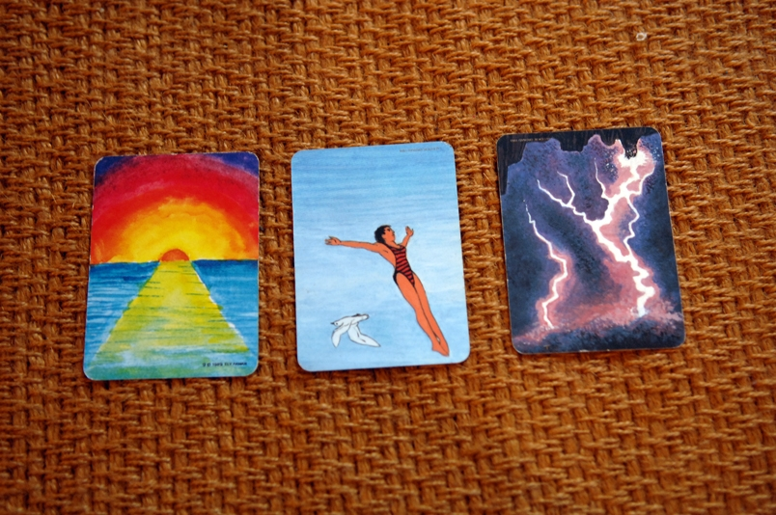
Past – present - future
Receiving cancer DX
Hoping for the future
At the end of the group

Slide 17
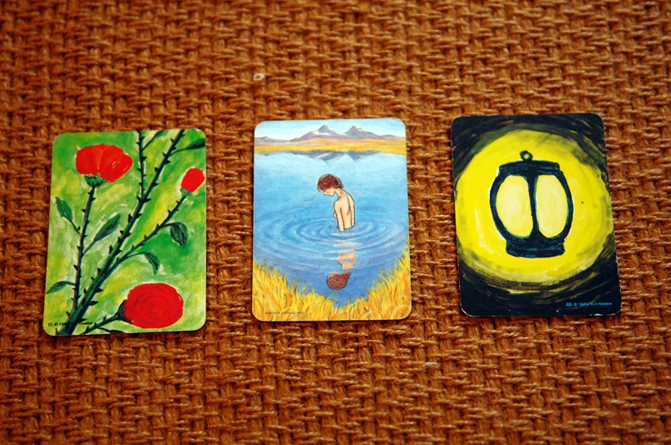
Hoping for the future
At the end of the group
Receiving the cancer DX

Slide 18
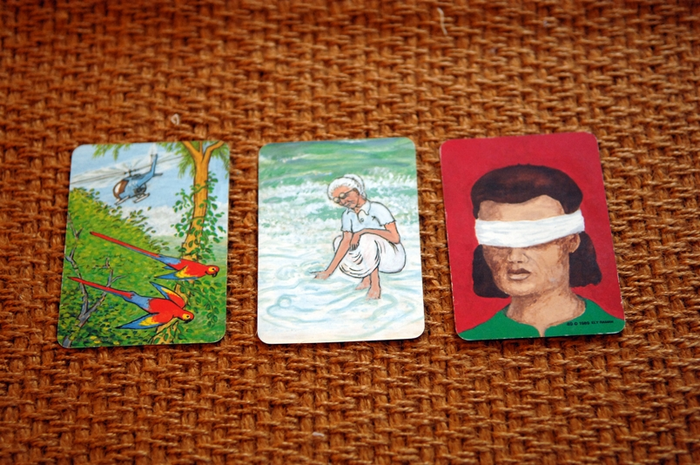
Past – present - future
......
Hoping for the future
At the end of the group
Receiving cancer DX
Thank you!

Slide 19
Hamama-Raz, Y., Perry, S., Pat-Horenczyk, R., Bar-Levav, R., Stemmer, S. (2012). Factors affecting participation in group intervention in patients after adjuvant treatment for early-study breast cancer. Acta Oncologica, 51, 208-214.
Pat-Horenczyk, R., Perry, S., Hamama-Raz, Y., Ziv, Y., Schramm-Yavin, S., Stemmer, S.M. (2015). Posttraumatic Growth in Breast Cancer Survivors: Constructive and Illusory Processes. Journal of Traumatic Stress, 28, 214-222.
Hamama-Raz, Y., Pat-Horenczyk, R., Perry, S., Ziv, Y., Bar-Levav, R., & Stemmer, S. M. (2016). The Effectiveness of Group Intervention on Enhancing Cognitive Emotion Regulation Strategies in Breast Cancer Patients: A 2-Year Follow-up. Integrative Cancer Therapies, 15(2), 175-182.‏
Pat-Horenczyk, R., Saltzman, L. Y., Hamama-Raz, Y., Perry, S.., Ziv, Y., Ginat-Frolich, R., & Stemmer, S. M. (2016). Stability and Transitions in Posttraumatic Growth Trajectories among Cancer Survivors: LCA and LTA Analyses. Psychological Trauma: Theory, Research, practice and policy, 8(5), 541-5419..
Hamama-Raz, Y., & Pat-Horenczyk, R., Roziner, I, Perry S. Stemmer, S. (2019). Can posttraumatic growth after breast cancer promote positive coping? A Cross-Lagged study. Psycho-Oncology.

